Slide 1
Employee Data Analysis using Excel
STUDENT NAME: HARSHINI S V
REGISTER NO : 312218929
NM I’D. : unm1699312218929
DEPARTMENT : B.com (GENERAL)
COLLEGE : AVICHI COLLEGE OF ARTS AND SCIENCE

Slide 2

PROJECT TITLE
Employee Performance Analysis using Excel

Slide 3

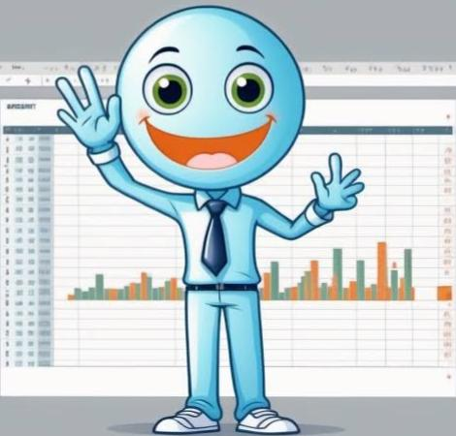

AGENDA
Problem Statement
Project Overview
End Users
Our Solution and Proposition
Dataset Description
Modelling Approach
Results and Discussion
Conclusion
3/21/2024 Annual Review

Slide 4

PROBLEM STATEMENT
Automating employee performance analysis in Excel aims to streamline data entry and tracking, standardize performance evaluation, enhance accuracy and consistency, facilitate data-driven decisions, and identify training needs and improvement areas. By leveraging Excel’s capabilities, we can create a user-friendly, efficient, and insightful tool for effective employee performance management.

Slide 5

PROJECT OVERVIEW
This project aims to develop an Excel-based Employee Performance Analysis System to track and evaluate employee performance, automate calculations and reporting, and provide data-driven insights for informed decisions, ultimately enhancing performance management efficiency. The system will feature customizable performance metrics, automated scoring and ranking, interactive dashboards and reports, and data validation and security. By implementing this system, we expect to improve accuracy and consistency, enhance employee engagement, enable data-driven decision making, and increase productivity.

Slide 6


WHO ARE THE END USERS?
Managers and supervisors
HR professionals
Executives and Leadership
Employees Themselves
Team Leaders

Slide 7

OUR SOLUTION AND ITS VALUE PROPOSITION
FILTERING - REMOVE VALUES
PIVOT TABLE - SUMMARY OF EMPLOYEE
PERFORMANCE
FLOW CHART - FINAL REPORT

Slide 8

Dataset Description
EMPLOYEE DATA SET - KAGGLE
9 FEATURES IN EXCEL:
EMPLOYEE ID - ALPHANUMERIC(TEXT)
NAME - ALPHABETICAL (TEXT)
GENDER - ALPHABETICAL (TEXT)
SALARY - NUMERICAL
JOB ROLE - ALPHABETICAL (TEXT)
FTE - NUMERICAL
MARITAL
STATUS - ALPHABETICAL(TEXT)
REMOTE WORK - ALPHABETICAL(TEXT)
COMPANY TENURE - NUMERICAL
3 FEATURES USED:
COMPANY TENURE - NUMERICAL
JOB LEVEL - NUMERICAL
WORK LIFE BALANCE - ALPHABETICAL(TEXT)

Slide 9
PROJECT FOCUS :
This project focuses on leveraging Excel to analyze employee data. Key tasks include;
**Data Organization:** Importing, cleaning, and structuring employee data for clarity and consistency.
2. **Analysis:** Applying Excel functions and formulas to assess performance metrics, filling missing values , and other key indicators.
3. **Visualization:** Creating charts, graphs, and pivot tables to visualize trends and patterns.
4. **Reporting:** Summarizing findings to inform HR strategies and decision-making.

Slide 10

THE “WOW” IN OUR SOLUTION
1. Effective data visualization makes it
easier to present complex data ion an
engaging and understandable way.
2. Well-presented impact on data have a
significant impact on decision-makers,
helping to drive change and innovation.
3/21/2024 Annual Review

Slide 11
MODELLING
STEP-1
DOWNLOAD THE EMPLOYEE DATASET AND OPEN THE EMPLOYEE DATASET IN EXCEL.
STEP-2
SELECT THE ENTIRE DATA AND CLICK ON DATA AND CLICK ON FILTER OPTION.
STEP-3
FILTER THE EMPLOYEE DATASET FROM A TO Z ORDERS
STEP-4
SELECT ENTIRE DATA AND CLICK ON INSERT AND CLICK ON PIVOT TABLE TO CREATE PIVOT TABLE.
11

Slide 12
STEP-5
DRAG THE NEEDED DATA AND CREATE A PIVOT TABLE.
STEP-6
SELECT THE PIVOT TABLE AND CLICK ON INSERT.
STEP-7
NOW CLICK ON THE CHART THAT YOU WANT.
STEP-8
THE CHART IS CREATED.

Slide 13
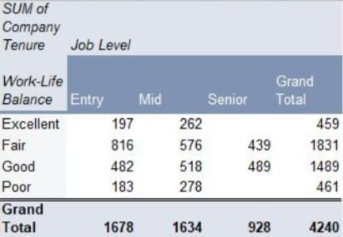
RESULT
1.PIVOT TABLE
13

Slide 14
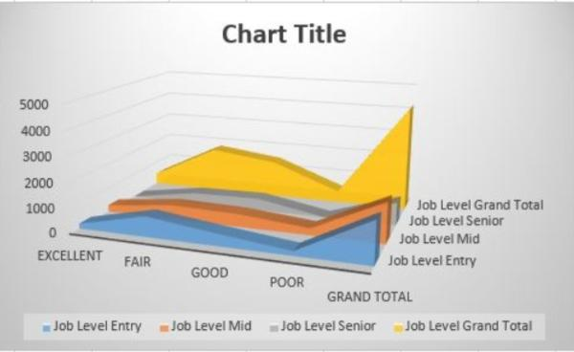
2.FLOW CHART

Slide 15

conclusion
The employee performance analysis has illuminated key aspects of our team’s strengths and areas needing improvement. The findings suggest that while many employees excel in their roles, there are opportunities for growth that can enhance overall productivity and effectiveness. By addressing identified weaknesses and leveraging our employees’ strengths. We can develop targeted strategies for professional development, optimize team dynamics, and align individual goals with organizational objectives. Continuous monitoring and iterative feedback will be crucial in sustaining performance improvements and achieving our long-term goals.

